Slide 1

beyond multiples
What matters for equity investors? A risk assessment approach for private companies.
Team_3:
Chakravorty - Gupta - Hufeld - Kirsch - Maerz
Notes:
Abseits von reinen Multiple-Bewertungen eine Analyse erstellt, um Erfolgsfaktoren von Startups zu suchen, bevor sie letztendlich an die Börse gegangen sind.

Slide 2
Outline
Introduction
Theory
Motivation
Data Preparation
Data Exploration
Data Analysis
Results I - Prediction & Quality
Results II - Feature Importance
Hypothesis answer using Results II
Conclusion

Slide 3
Introduction
investment = “allocation of capital with expectation of future financial return”
privately held, owner = “founder, private group of investors”
What matters for equity investors? A risk assessment approach for private companies
equity = “ownership”
control
participation
risk = “loss in value of capital allocated in absolute or relative terms”
assessment via fundamental evaluation

Slide 4
Introduction
Focus on: private companies
Private companies
Public companies:
Low transparency, low information
High transparency, vast information
Shorter company history, no track record
Longer company history, track record
Early in life cycle, high growth, high risk phase
More stability, financial data meaningful

Slide 5
Introduction
Focus on: later stage private investments, investors staying for IPO
Focus on growth
Focus on present and future payoffs
EV of Firm
25k
100k
500k
1 m
3m
5m
10m
...
Entrepreneurs
Financing Needs
Business Angels
Venture Capital
Private Equity
Public Listing

Slide 6
Wrap-Up
Take point of view of investor into private companies
Focus here on specific subgroup of private companies:
Later stage (not start-up phase), but prior to IPO
“Start-up origin”: no carve outs, “old” private companies
Now how to assess risk?
information scarcity
all have IPO’ed
only founded recently
what valuation technique?

Slide 7
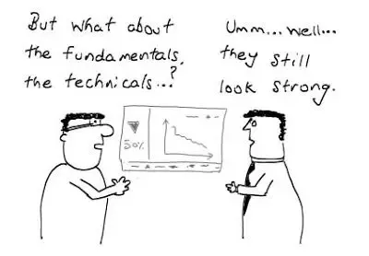
Theory - Relying On DCFs As Usual?
Classic fundamental valuation techniques:
i) Discounted Cash Flow (DCF) technique:
Theoretically most accurate and established method
Basic idea: value of a firm depends on present value of future free cash flows the firm generates and some risk factors
Complicated to apply to our set of companies?
Notes:
deduce free cash flows based off past company financials, business plan, management and view on market
determine terminal value
discount to present via determined cost of capital

Slide 8
Where DCFs Break Down
Free Cash Flow (FCF):
Usually forecast 3-5 yrs before terminal value
Rely on business plan, analysis of market potential,
Verify FCFs by looking at margins (profitability) and quotes (WC) of peers in similar stage
Breakdown:
10 years needed: hard to model meaningfully into future that far away
High reliance on terminal value (assumption-driven)
Operating income can be negative
Data needed for forecasting hard to derive due to short company histories
Notes:
(need 10 yrs to model business conditions after high growth phase)

Slide 9
Where DCFs Break Down
Going concern assumption:
Business functioning without threat of liquidation in near future
Capital costs (WACC):
Cost of equity: usually modeled statistically via CAPM, usually exposure to systemic risk
Cost of debt: market price relevant peers
Breakdown:
High default probability for our type of companies, needs to be accounted for
Highly idiosyncratic risk companies, no diversification of risk possible in portfolio of private firms
Hard to find peers for some of these business models (“disruptive”)
Notes:
can do scenario analysis, but also breaks down
The CAPM implies that the expected return on an asset is linearly related to its beta, which measures the (scaled) covariance between the asset’s return and the market return.

Slide 10
Theory - Rescue In Multiples?
ii) Multiples valuations:
Simple technique, valuing a target company “just like” comparable firms are currently priced by investors
E.g.: Company x has EPS of 2.5€ → if Peer Group P/E at 6x → Price: 2.5€*6 = 15€
Snapshot in time: No multi-year forecasts required
No discount rate / growth rate estimation required
Assumption: Pricing of comparables is on average correct
Simplicity usually means sloppiness, but here advantage?

Slide 11
Where Multiples Break Down
Applicable peer multiples:
equity vs. EV valuation of income statement items (sales, EBIT(DA), ...)
Comparability:
use firms from peer group or related transaction multiples
Breakdown:
everything below topline may be negative (no meaningful ratios)
resorting to Price/Sales or EV/Sales dilutes information on FCF potential and profitability
hard to find peers for some of these business models (“disruptive”)
transactions include premia
Notes:
Public vs. private company scope: public peers usually not in high growth phase anymore

Slide 12
Motivation
Companies
OBSTACLES
IDEA
recently founded
“true” start-ups
have IPO’ed
short company history
negative earnings
low transparency
data-driven approach
point out determinants of successful companies
information only available pre-IPO
Notes:
Very challenging to apply classic fundamental valuation techniques to this set of private companies: recently founded, “true” start-ups that have now IPO’ed
Obstacles: short company history, negative earnings, high default probability, very high growth, low transparency
In this space, financials are less relevant than potential, plan and most importantly people (execute plan)!
Idea: overcome limits by classic fundamental valuation techniques using data driven approach to point out determinants driving successful companies (different success measures) using features used are only info available pre-IPO to an investor

Slide 13
The Data - Introduction
Crunchbase
Factset
Start Ups
IPO Data
Funding Rounds
Founder Data
Investors
Benchmark Data

Slide 14
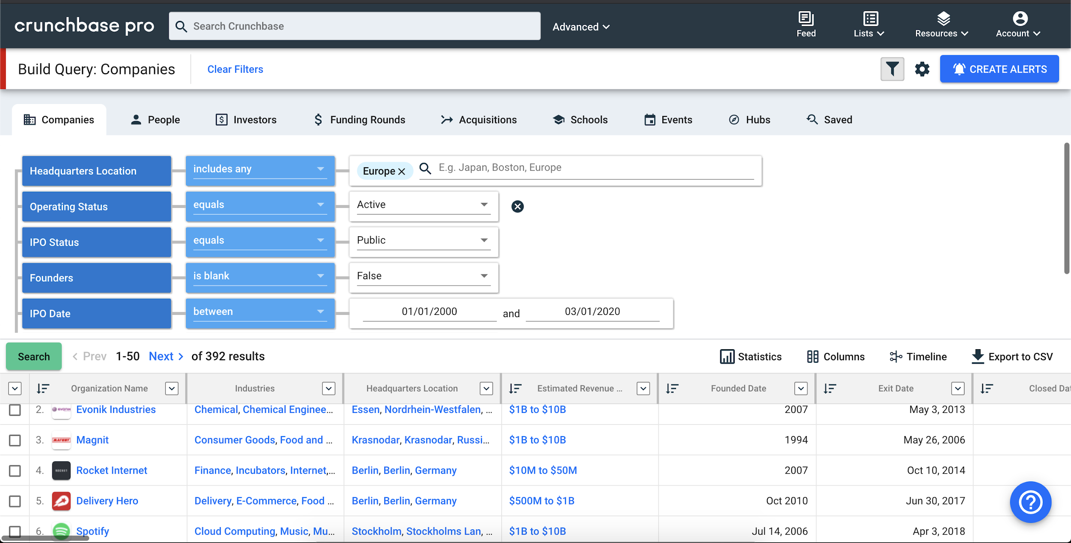
The Data - Crunchbase

Slide 15
The Data - Crunchbase Selectors
Regio
HQ Location
Operating Status
Active
IPO STATUS
Public
Founders
known
Founded Date
1990 - TOday
IPO Date
2000 - today
Funding Status
IPO

Slide 16
The Data - Joins
stock symbol
Crunchbase
Factset
Factset ID
country code

Slide 17
The Data - Joins II
Crunchbase
Start Ups
Funding Rounds
Investors
seperate & relational Data Sheets

Slide 18
The Data - Features
Start Ups
Funding Rounds
Investors
Region
total number
total number
X
Industry
total Amount
Lead INvestors
Founders
Funding Rate
Valuation
Stock performance
Benchmark Performance
y

Slide 19
The Data - Clean Features
Founders
Funding
Investors
(Founding) Age
Amount per round
Number of Investors
Uni Degree
Number of ROunds
Investor Experience
Gender
Valuation
Lead Investors
Experience
Funding Rate
Investor Rate

Slide 20
The Data - Target Variable
Regression
Classification
performance Rate
performance class
vs. Benchmark
vs. Benchmark
e.g. +22% or -2%
1 (above) or 0 (below)

Slide 21
The Data - Quality Splits
Includes Valuation Data
Dataset I:
~1250 companies
insufficient data
Dataset II:
~120 companies
sufficient data
DUe to Lack of: Valuation, funding and IPO Data

Slide 22
What is it we are analysing?
Our Dataset:
once proper Startup
went public
Out of Startups that became listed companies, what early indicators determine a successful six month return on the stock market?

Slide 23
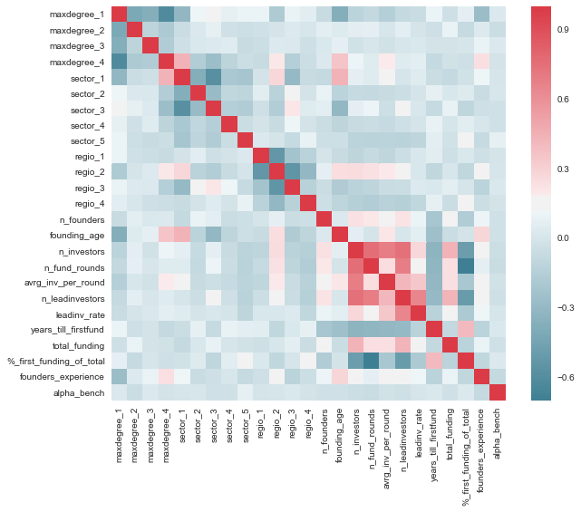
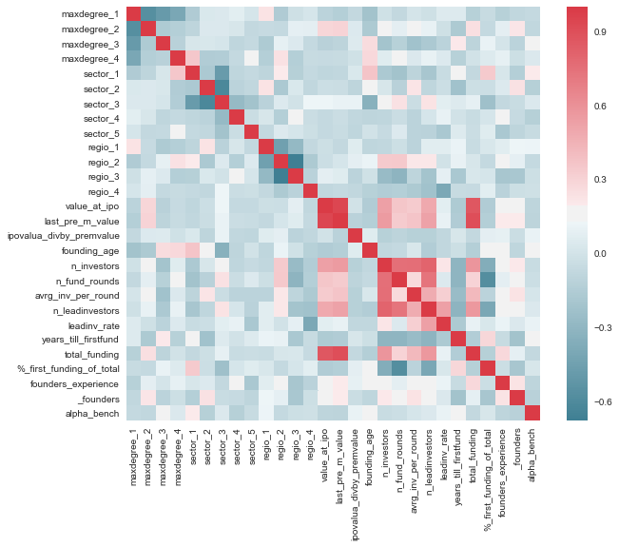
Feature Correlations I

Slide 24
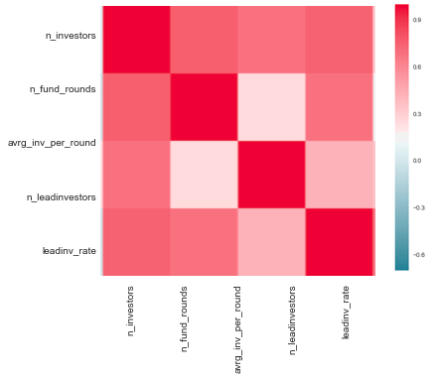
Feature Correlations II

Slide 25
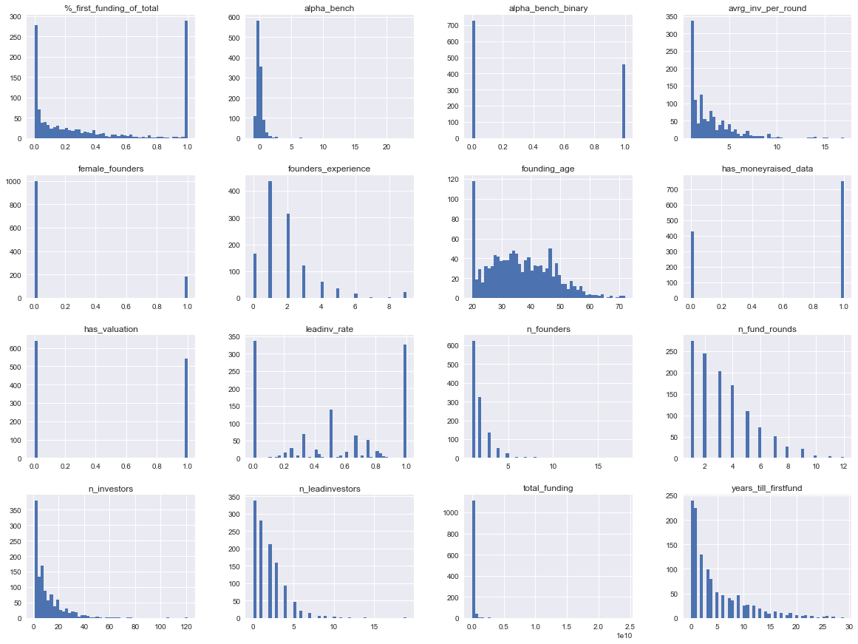
Feature Distributions

Slide 26
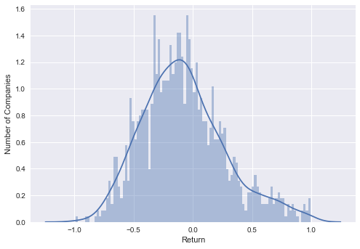
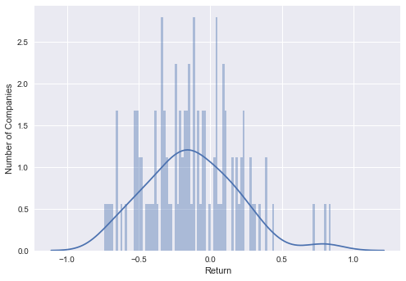
Target Variable Distribution
same for set 3

Slide 27

Most Founders

Slide 28

Most Funding Rounds

Slide 29

Most Lead Investors

Slide 30
Data Analysis
MOdel
Data Split
Split Quality
Data Normalization
Model Finetuning

Slide 31
Results I - Performance Measures I
Accuracy:
A ratio of correctly predicted observation to the total observations with no consideration for false positives and false negatives
Precision:
Ratio of correctly predicted positive observations to the total predicted positive observations. High precision relates to the low false positive rate

Slide 32
Results I - Performance Measures II
Recall:
(Sensitivity) - the ratio of correctly predicted positive observations to all positive observations. Or: Of all the “yes” labels, how many did we predict?
F1 score:
Weighted average of Precision and Recall. Taking both false positives and false negatives into account, F1 is usually more useful than accuracy. If the cost of false positives and false negatives are very different, it’s better to look at both Precision and Recall instead of accuracy.

Slide 33
Regression Results
Dataset I
Dataset II
R2: -0.01
R2: -0.09
RMSE: 1.76
RMSE: 0.36
MAE: 0.47
MAE: 0.29
MAPE: 249.35
MAPE: 104.42

Slide 34
Path Of Choice
Regression
Classification
Target:
Rate of Return
Target:
Binary Performance
DUe to Lack of: Valuation, funding and IPO Data

Slide 35
Classification Results
Dataset I
Dataset II
Precision: 0.55
Precision: 0.7
Recall: 0.75
Recall: 0.875
F1: 0.63
F1: 0.78
Accuracy: 0.58
Accuracy: 0.75

Slide 36
What matters?
(Hidden) Factors that have a measurable long term impact

Slide 37

What’s In The Box?
X
y
Predictor
Results
Feature Importance

Slide 38
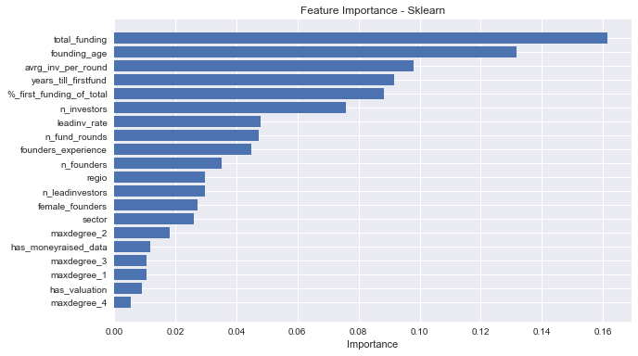
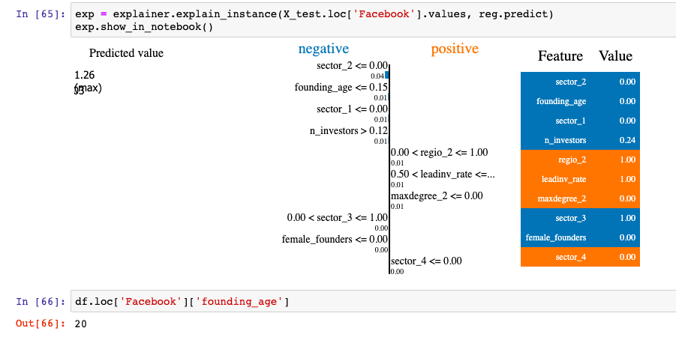
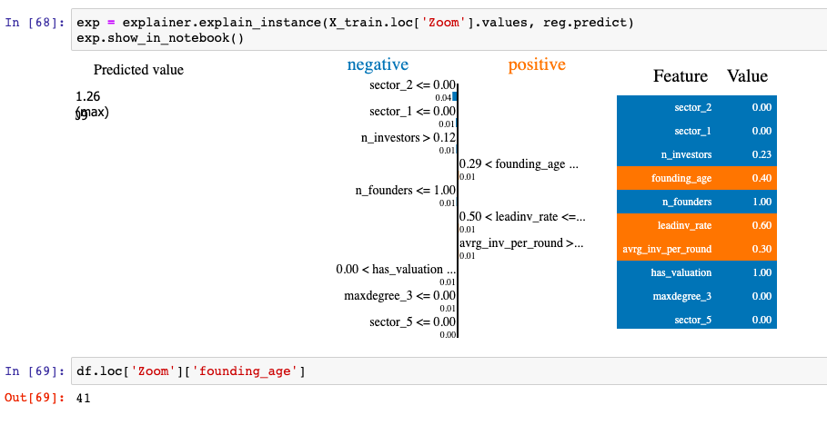
Results II - Feature Importance
model.feature_importances_
lime.lime_tabular
feature list sorted by impact
individual feature impact

Slide 39
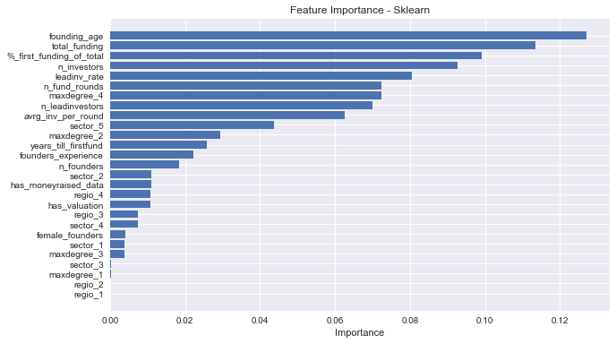
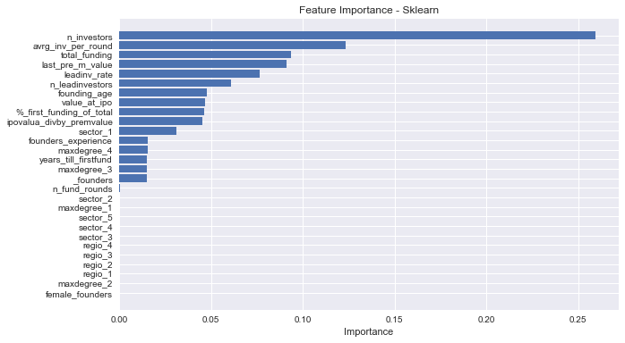
Important Features
Data Set I
Data Set II

Slide 40
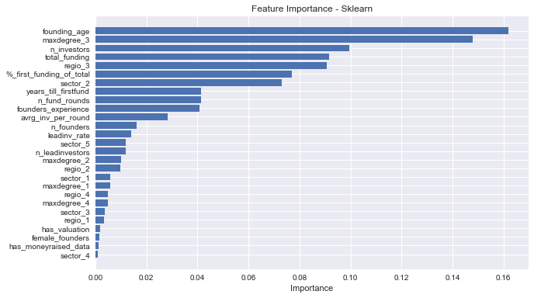
Important Features
Data Set I Regression
Data Set I Classification

Slide 41
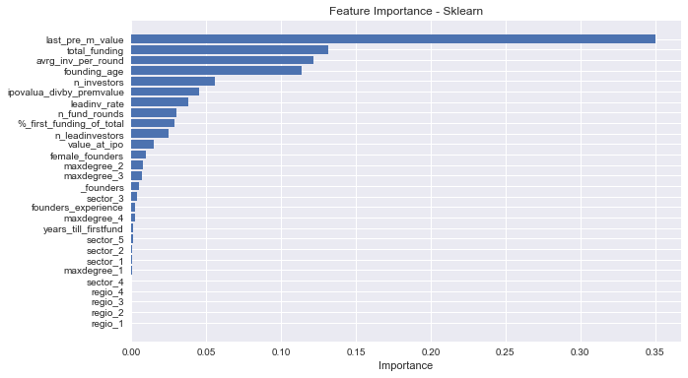
Important Features
Data Set II Regression
Data Set II Classification

Slide 42




Are Unicorns Real?

Slide 43
50/50 according to our findings:
Number of Investors
Number of Investors
Number of Investors
Number of Investors
65
71
27
16
Average Inv per Round
Average Inv per Round
Average Inv per Round
Average Inv per Round
8,13
7,89
3,86
2,67
TOtal Funding
TOtal Funding
TOtal Funding
TOtal Funding
~95.000.000.000USD
~66.000.000.000USD
~2.900.000.000USD
~829.000.000USD

Slide 44
Shortcomings - One Common Story
Quest for Data
Funding
Valuation
Hype
too Sparse and thus not suitable for confident predictions
SHould include media and expert echo

Slide 45
Twitter Sentiment Pitfalls I
Information is key when making investment decisions
Twitter and other social media give people ways to express opinions about companies or share facts in real time
Revolutionary ideas can build up hype and high expectations
Question:
Should the level people talk about a company, in both positive and negative tone, influence investment decisions?

Slide 46
Twitter Sentiment Pitfalls II
The data you would need
a) has to be available for a long time horizon (sentiment change)
b) has to be thoroughly cleaned (marketing, influencers etc)
c) needs to be cross checked with other sentiment sources like newspaper archives or Google Trends
d) to us simply wasn’t available

Slide 47
Twitter Sentiment Pitfalls III
This is why we failed:
Number of Companies x Number of days / 35
15
Waiting time between downloads

Slide 48
Conclusion - Path Of Resignation
IDea I:
Analyse private comp. valuation and Bidding Data
IDea II:
predict IPO success for private companies
IDEA III:
Find Success indicators beyond mere multiples
no. Scarce Data, we did not find a magic solution.
no. Using mostly Metadata brings to little to the table.
Good enough! Guide intuition on early success factors with quantitative approach.

Slide 49
Viable Idea?
instead of common metrics, e.g.:
User Growth
Revenue growth
all kinds of growth
Go below: What principles guide entrepreneurial success?
Founders
Investors
Timing

Slide 50
A Bang For Your Buck? Look Out For:
Indicators:
Number of Investors
Average funding per round
Total Funding
Founders Age

Slide 51
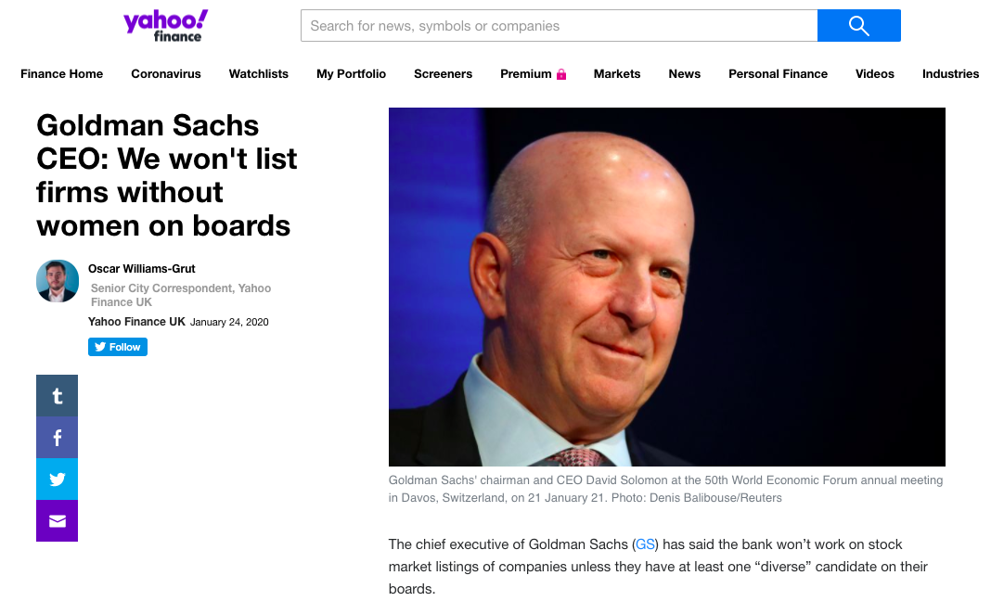

Slide 52
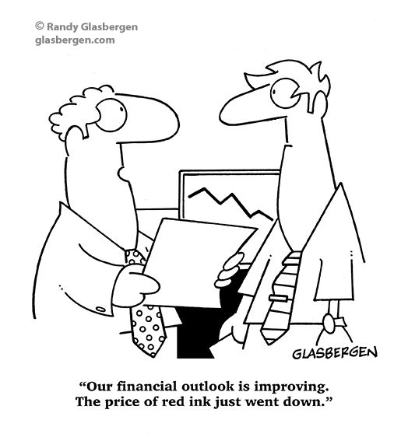
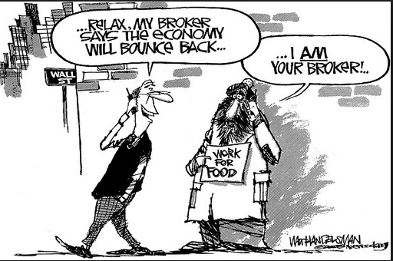

Slide 53
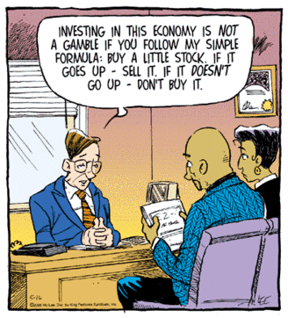
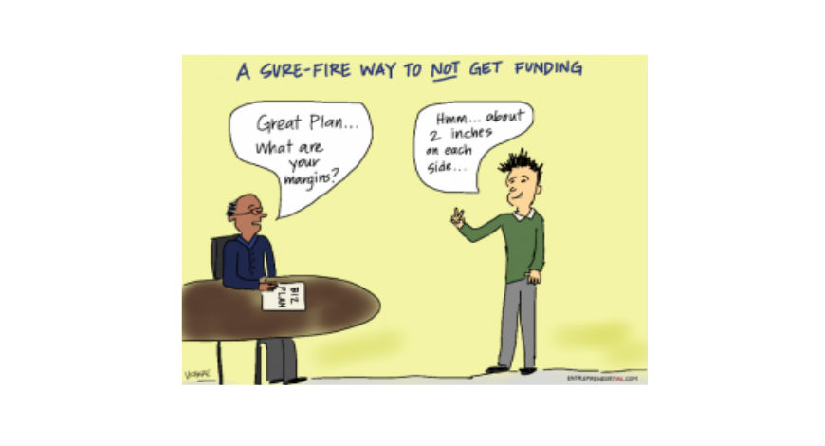

Slide 54
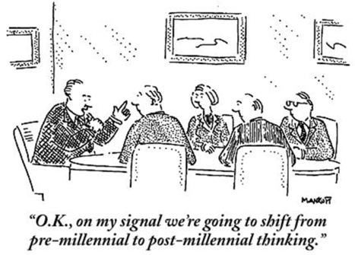


Slide 55
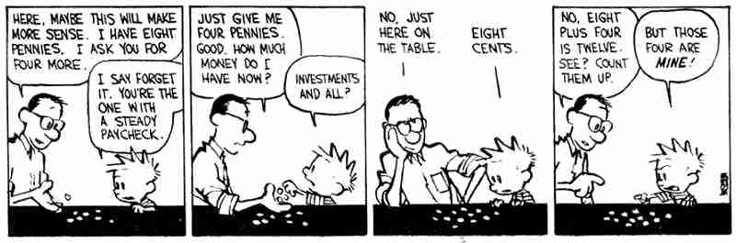
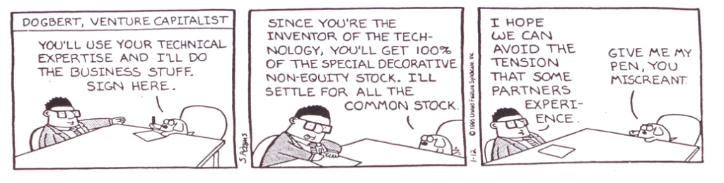

Slide 56


Slide 57
